Slide 1
Science: Newtons Laws

Slide 2
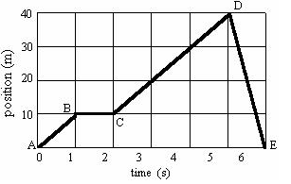
Position-Time graphs
Jack is out trying to find water, the graph shows his position-time to keep track of where he has been.
What is happening from Point A to B?
What is happening from Point B to C?
Calculate the velocity from point C to D.
What is happening from Point D to E?
During which points is the man moving the fastest?
What is the man’s displacement from point A to D?
What is the man’s displacement?

Slide 3
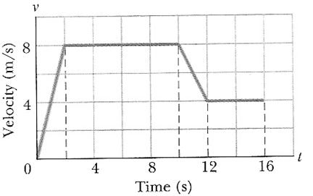
Velocity-Time Graphs
What is happening in section A?
What is happening in section B?
What is happening in section C?
What is happening in section D?
B
C
A
D

Slide 4
Newton’s first Law
An object in motion stays in motion and an object at rest stays at rest unless acted on by a greater force.
Inertia-a property of matter by which it continues in its existing state of rest or uniform motion in a straight line, unless that state is changed by an external force.

Slide 5
Balanced Force
Equal forces in opposite
directions produce no motion

Slide 6
Unbalanced Forces
Unequal opposing forces
produce an unbalanced force
causing motion

Slide 7
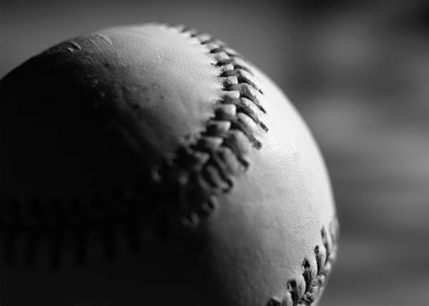
If objects in motion tend to stay in motion, why don’t moving objects keep moving forever?
Things don’t keep moving forever because there’s almost always an unbalanced force acting upon them.
A book sliding across a table slows down and stops because of the force of friction.
If you throw a ball upwards it will eventually slow down and fall because of the force of gravity.

Slide 8
1st Law
Unless acted upon by an unbalanced force, this golf ball would sit on the tee forever.

Slide 9
What is this unbalanced force that acts on an object in motion?
Friction!
There are four main types of friction:
Sliding friction: ice skating
Rolling friction: bowling
Fluid friction (air or liquid): air or water resistance
Static friction: initial friction when moving an object

Slide 10
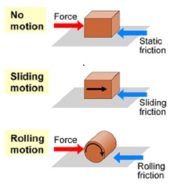
Types of Friction

Slide 11
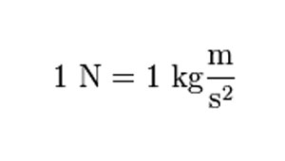
Newton’s second Law
F= m x a
Force=measured in Newtons
Mass
Acceleration

Slide 12
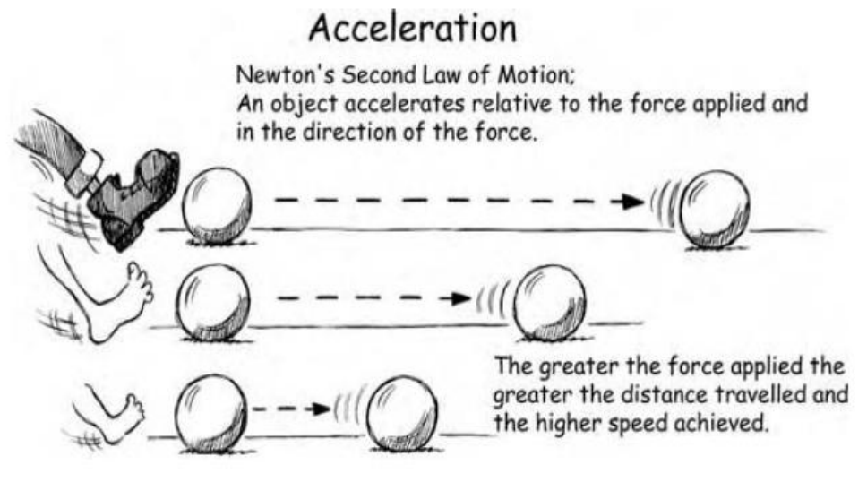
Newton’s Second Law

Slide 13
Newton’s Second Law

Slide 14
Newton’s Second Law

Slide 15
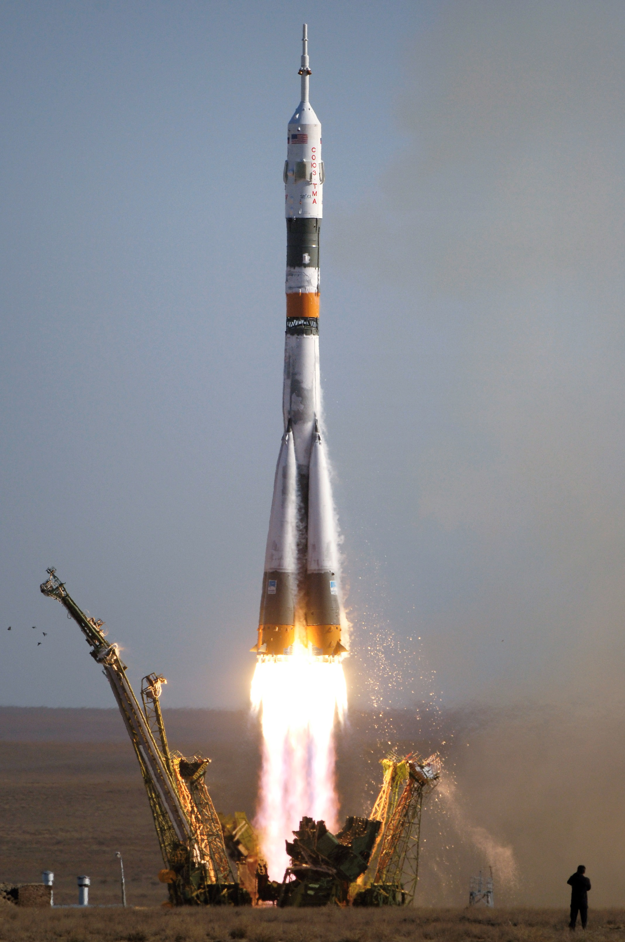
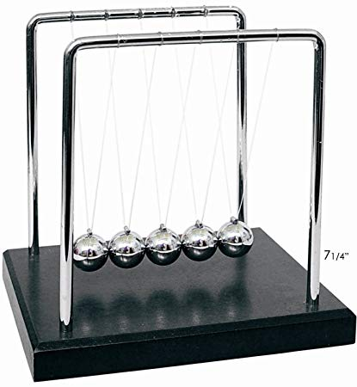
Newton’s Third Law
For every action, there is an equal and opposite reaction.

Slide 16
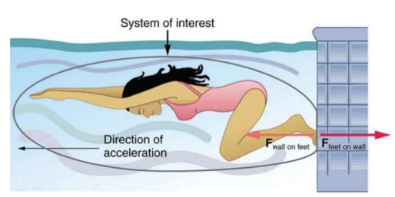
Newton’s Third Law
For every action there is an equal and opposite reaction.

Slide 18
Newton’s Third Law
A bug with a mass of 5 grams flies into the windshield of a moving 1000kg bus.
Which will have the most force?
The bug on the bus
The bus on the bug

Slide 19
Newton’s Third Law
The force would be the same.
Force (bug)= m x A
Force (bus)= M x a
Think I look bad?
You should see
the other guy!

